Slide 1

Social Engineering: Hacking People
Mladen Prajdić
Data Platform MVP
mladenp@gmail.com
@MladenPrajdic

Slide 2

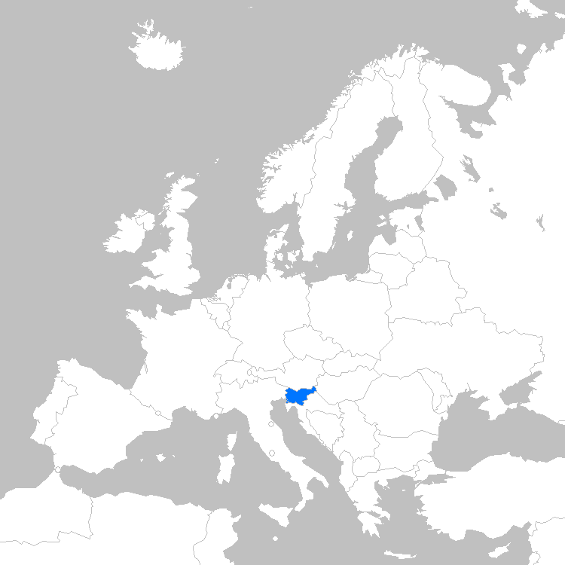



About me
Welcome to Slovenia
The sunny side of alps!

Slide 3
DataGrillen session, yet no awesome SQL content at all. GASP!

Slide 4
DataGrillen session, yet no awesome SQL content at all. GASP!

Slide 5
DataGrillen session, yet no awesome SQL content at all. GASP!

Slide 6
Perception It matters!

Slide 7
Company Attack Vectors
Website
SQL Injection, XSS, CSRF, DDOS, Ransomware
Social Engineering
Exploit the human
Others
GCHQ, NSA, CIA, etc ☺

Slide 8
Amateurs hack systems, professionals hack people

Slide 9
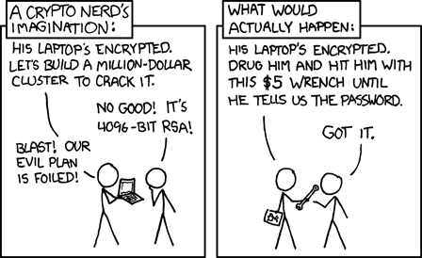
Tech Solution vs People Solution
http://xkcd.com/538

Slide 10
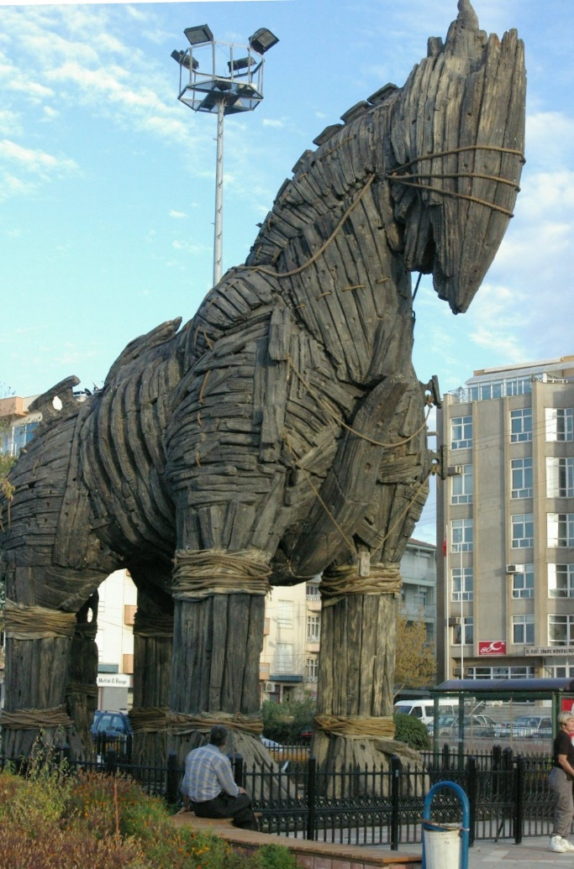
A few examples…
cca 1300 BC
Trojan horse
Wikipedia

Slide 11
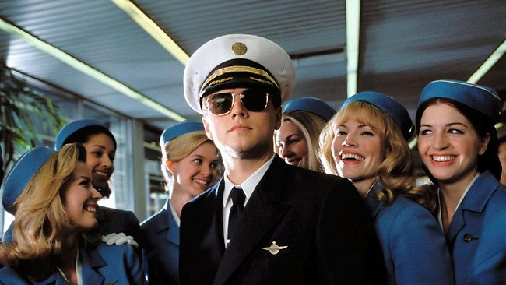
A few examples…
1964
Frank Abagnale Jr. Pretty much everything. Pilot, lawyer, doctor…
Wikipedia

Slide 12
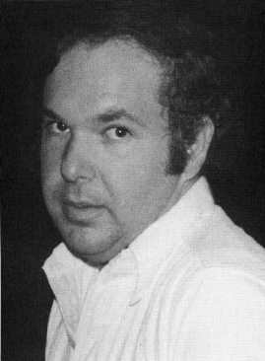
A few examples…
1978
Stanley Mark Rifkin defrauded the Security Pacific National bank in Los Angeles managed to steal
$10 million in a single social engineering attack.

Slide 13

A few examples…
2007
A mystery man walked out with €21 million worth of diamonds from a bank in Belgium. Charm, chocolates, nice guy, got keys copied.
Wikipedia

Slide 14

A few examples…
Every single day from beginning of history
Kids at home.
https://www.flickr.com/photos/23370518@N05/

Slide 15
Social Engineering
Exploits a person’s kindness and willingness to help
Investment in security awareness in non-IT employees: Minimal to Non-Existing
It is much easier to trick someone into giving a password for a system than to spend the effort to crack into the system (Kevin Mitnick)

Slide 16




Profiling

Slide 17
Contact - Calling
Call centers
Pretending to be support or customer
Direct calls to people
Leaving a message about infected computer, you call back
Pretending to be utilities companies, banks, etc.
Voice, calmness, authority

Slide 18
Contact - Calling
kbd-audio: Keytap
https://github.com/ggerganov/kbd-audio
It can guess pressed keyboard keys only by analyzing the audio captured from the computer's microphone

Slide 19
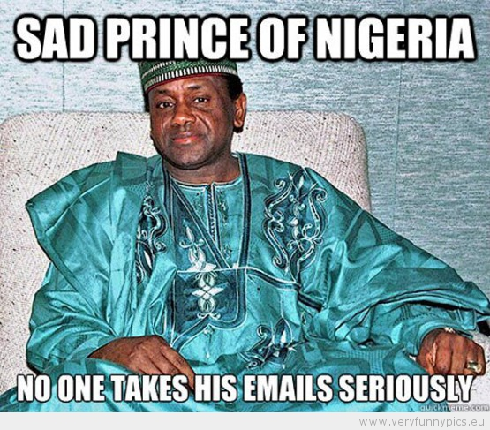
Contact - Phishing
Emails
Fake pages
Usually No HTTPS
Weird domain names
Spam filters
Hover over the links
Target location
PhishTank.com
DecentSecurity.com

Slide 20
Unicode URL Security Issues
Internationalized domain name (IDN) homograph attack
Homoglyphs
0 and O, I and 1, l and I
Chars that look like but have a different meaning
Homograph
words spelled alike but different in meaning or derivation or pronunciation
bow of a ship, a bow and arrow

Slide 21
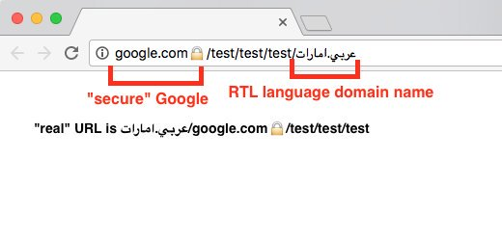
Contact - Phishing
An interesting phishing URL
Would you be fooled?

Slide 22
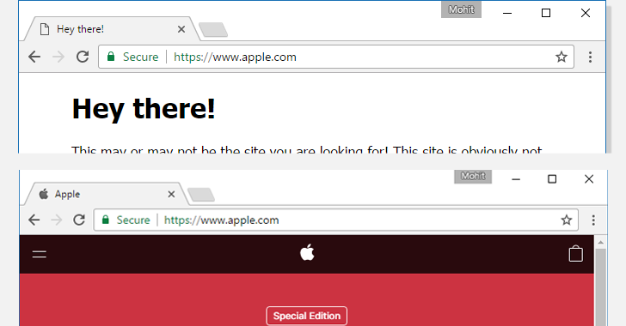
Contact - Phishing
How about this one?
Cyrilic a
(U+0430)
ASCII a
(U+0041)

Slide 23
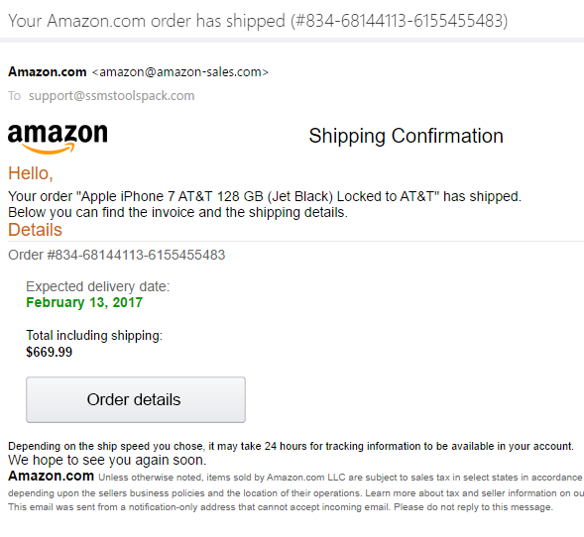
Contact - Phishing

Slide 24
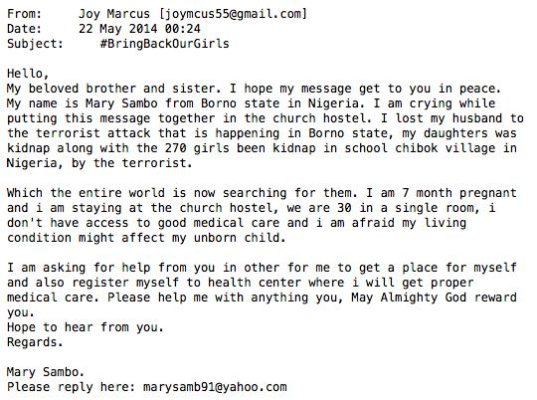
Emotional motivators
Compassion
Anger
Fear
Feel-good reward

Slide 25
Contact – AI
High quality AI generated human videos
Compromising fake videos
Blackmail
Doesn’t matter if fake

Slide 26
Contact – In person
Small talk
Giving away information not perceived to be important
OS, browser, VPN client, WiFi, Anti-virus,…
Other more personal info
Shoulder surfing
Dumpster diving

Slide 27
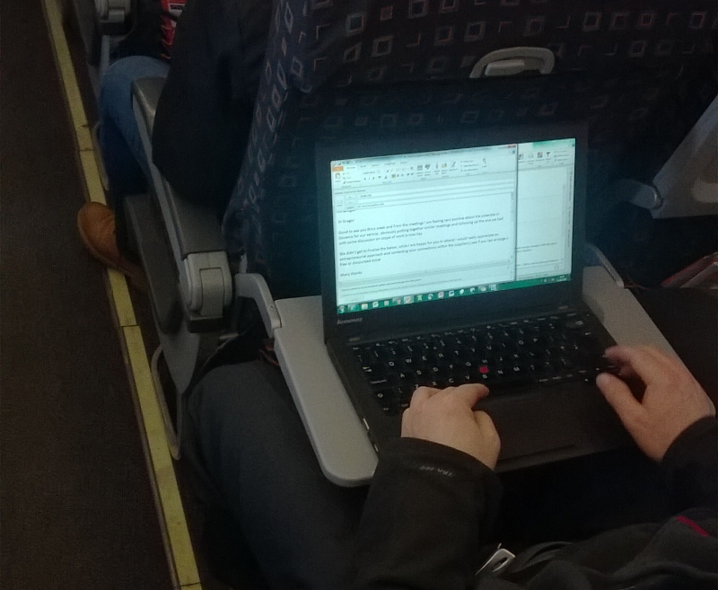
Shoulder Surfing

Slide 28
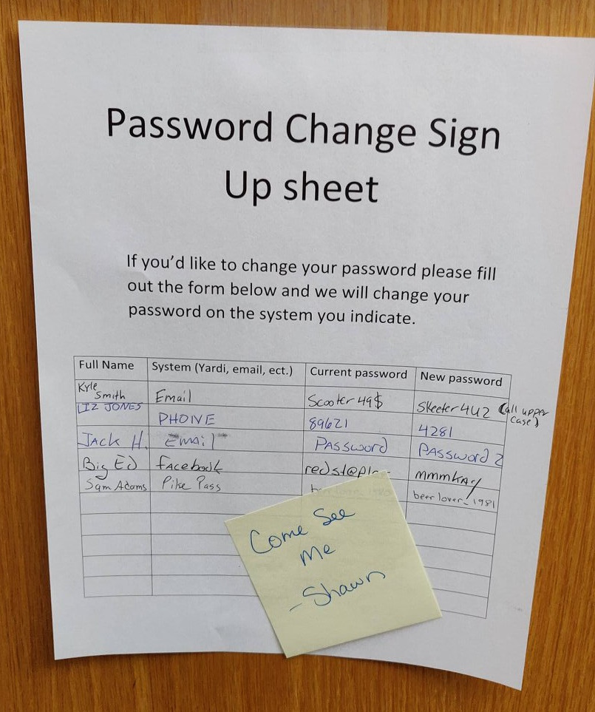
Being cheeky

Slide 29
Elicitation
The subtle extraction of information during an apparently normal and innocent conversation
Social engineer must be comfortable with himself and the role he plays
Rapport
Trust
Get information/access we want
Attack the target

Slide 30
Rapport
Rapport is a close and harmonious relationship in which the people or groups concerned understand each other's feelings or ideas and communicate well
Once you have it, trust level increases dramatically
Body language
Being genuine
Appeal to ego
Understanding communication style
Visual, Auditory, Kinesthetic (feeling, touch)
Anchoring

Slide 31
Body Language
Breaching personal space
Approach direction
Facial expressions
Body orientation direction

Slide 32
Be Genuine, Appeal To Ego
Be actually interested
Listen, hear
Carry on conversation
Give praise
Compliment
Tell to do instead of asking
But not too much, or you’re creepy ☺

Slide 33
Communication Style
Visual
“Ahh, I see.”
Auditory
“Excellent, I hear you!”
Kinesthetic (feeling, touch)
“Cool, I can grasp that.”

Slide 34
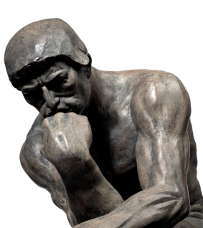
Anchoring

Slide 35

Anchoring
https://commons.wikimedia.org/wiki/Category:Confusion#/media/File:Confused_Felipe.jpg

Slide 36
Anchoring
Linking action to thought
Can be word, hand movement, sound
Pavlov dogs
Training since childhood for standard social reactions

Slide 37
The “powerful” combo
Confidence
and
“Because”

Slide 38
Elicitation
Honesty is the key to a relationship.
If you can fake that,
you’re in

Slide 39
“Advanced” level
Hot women/men in bars
“Forgotten” or free USB sticks
Basically they need prior preparation

Slide 40
How good are they?
Success rate:
100%

Slide 41
Social Engineering – Prevention
Common Sense
Education
Single day of education: Success goes 20% -> 90%
Two-Factor authentication
Spam filters, Browser protections
Data destruction, Paper shredding
Physical security

Slide 42
Social Engineering
Clean up cost
for company between $25,000 and $100,000
per incident

Slide 43
Things to Remember
Split your security budget
80%: sysadmin education
20%: people education
Common Sense
Metasploit
Social-Engineer Toolkit (SET)

Slide 44
Invitation
After this sessions, the drinks are on me!
I have been socially hacked by my Slovenian friend!

Slide 45
Trust but verify!

